Slide 1


Mind Sending
Supervisor: - Lam Huu Khanh Phuong
Members: - Ngo Minh Tan - Leader
- Nguyen Huu Thang
- Nguyen Luu Hong Son

Slide 2
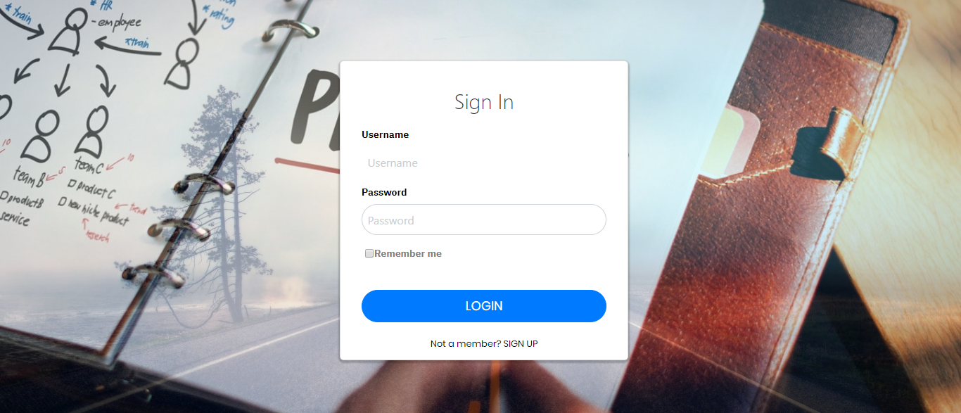
01
Introduction
02
Issues
03
CONTENT
Idea & Solution
04
Outcome
05
Future Plan
06
Future Plan
07
Q & A

Slide 3

1. Introduction
What?
Why?
How?

Slide 4

1. Introduction
What?
Why?
How?

Slide 5
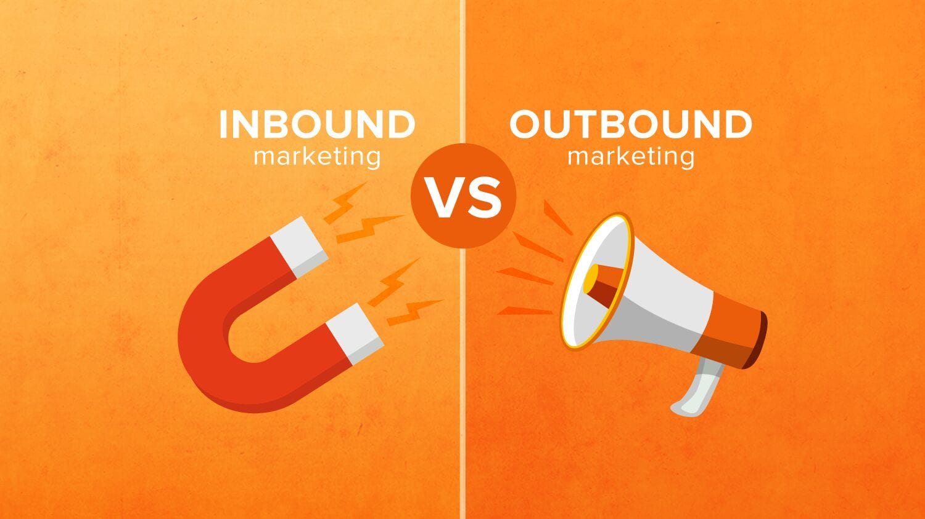
1. Introduction
What?
Why?
How?

Slide 6
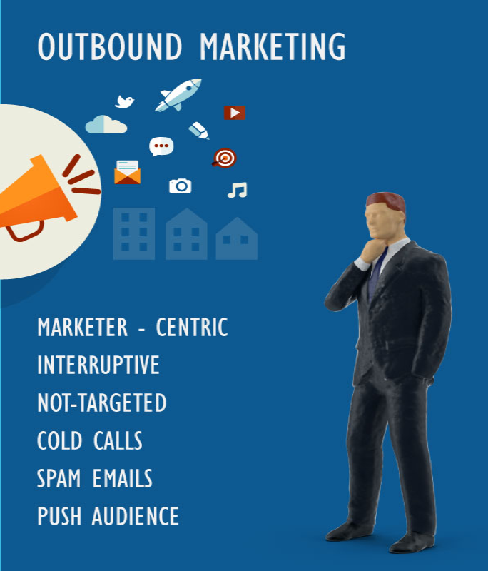
1. Introduction
What?
Why?
How?

Slide 7
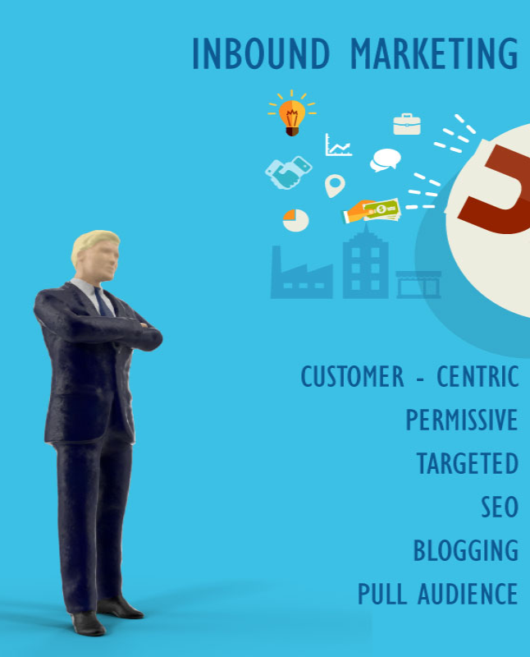
1. Introduction
What?
Why?
How?

Slide 8

1. Introduction
What?
Why?
How?

Slide 9

Email marketing
Minimize the cost

Slide 10

Email marketing
High success rate

Slide 11

Email marketing
High speed and easy to use

Slide 12
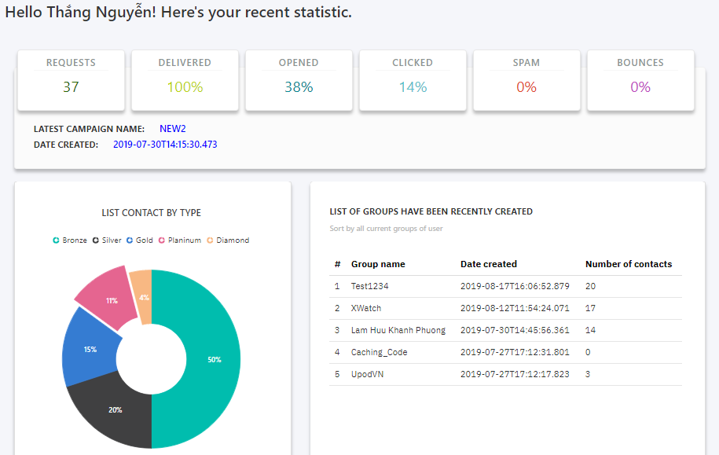
Email marketing
Detailed statistics

Slide 13

Email marketing
Aim for the right target

Slide 14

Email marketing
Flexibility in design

Slide 15

Email marketing
Increase brand awareness and keep relationships with customers

Slide 16

2. Issues
Low Delivery Rate
Low Open Rate
Low Click Rate
High Spam Rate
Low Active Ratio
Limited Post-Click Activity

Slide 17
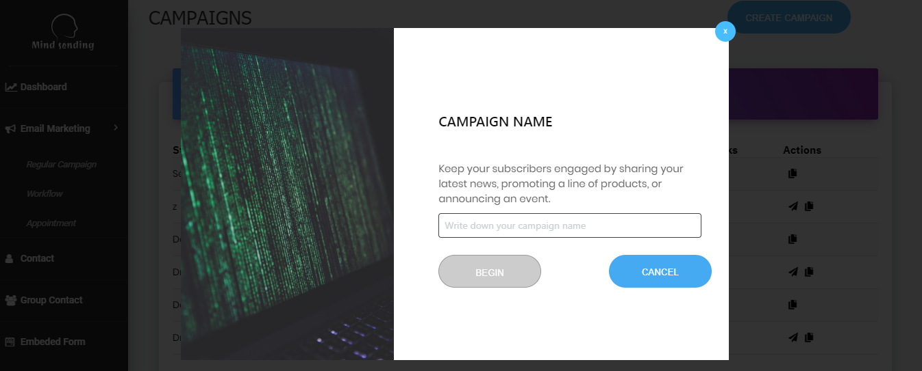
3. Idea & Solution
What?
Why?
How?

Slide 18
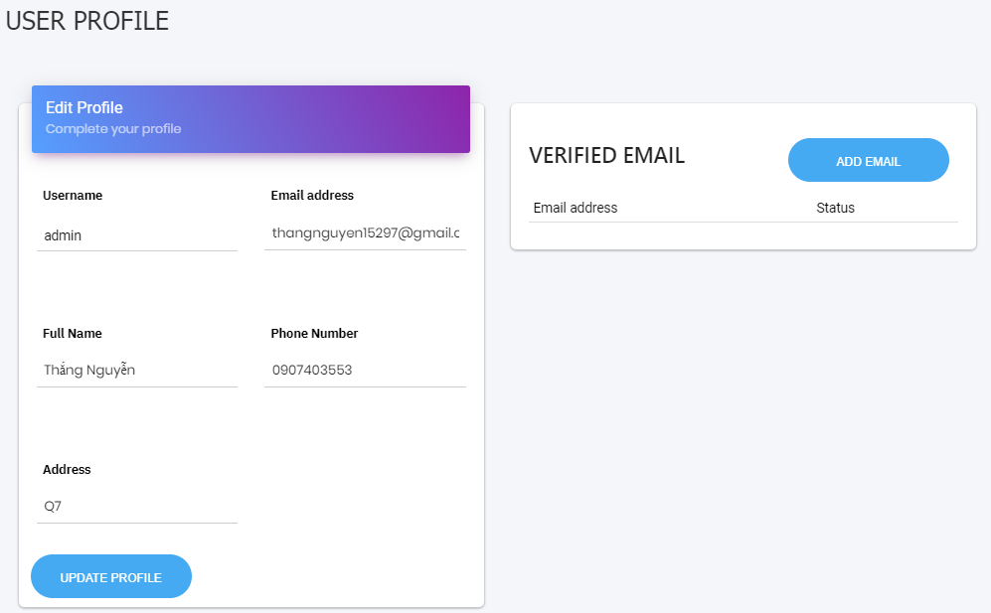




User profile
Update profile
Add verify email
15

Slide 19
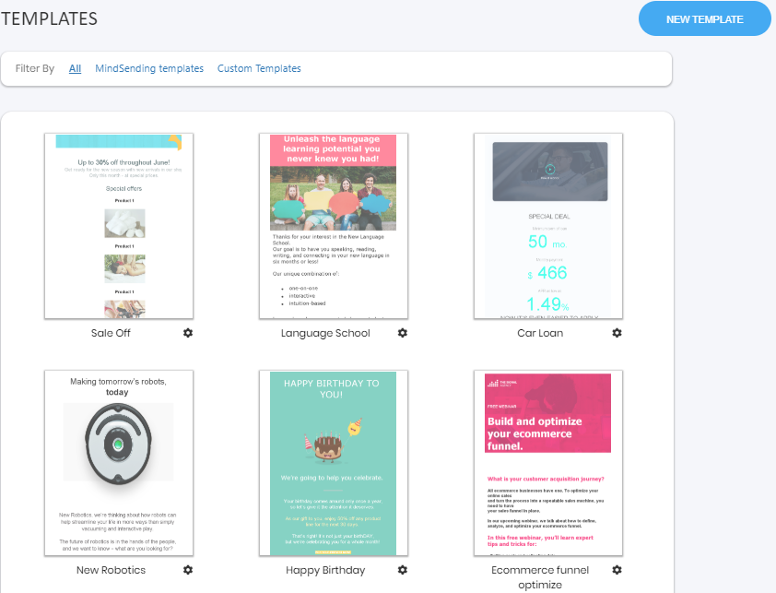




Template
Create template
Preview template
Edit template
Copy template
15

Slide 20
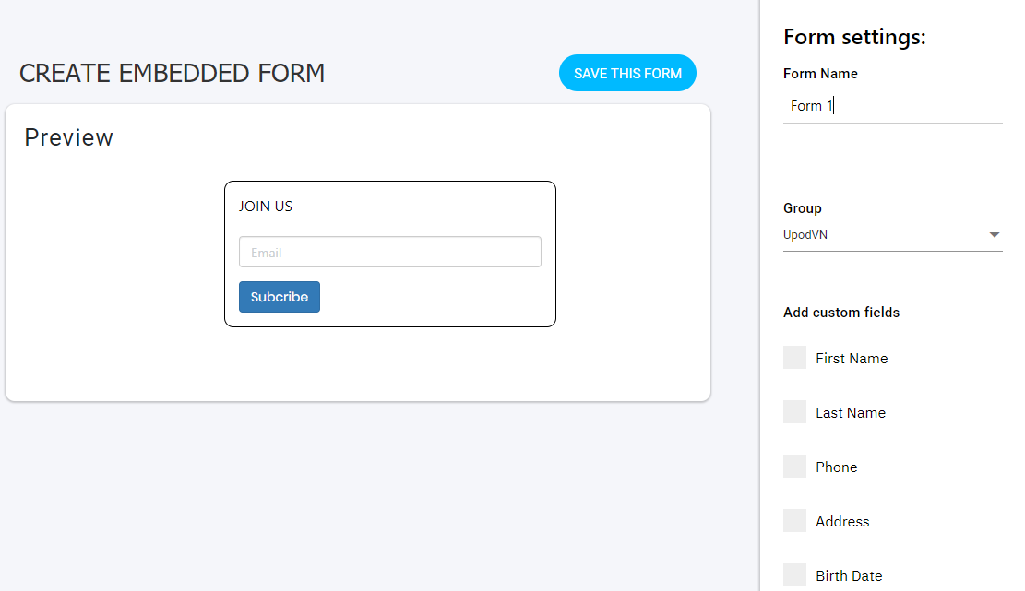
Embed form
Create form
Copy code
Preview form
15

Slide 21
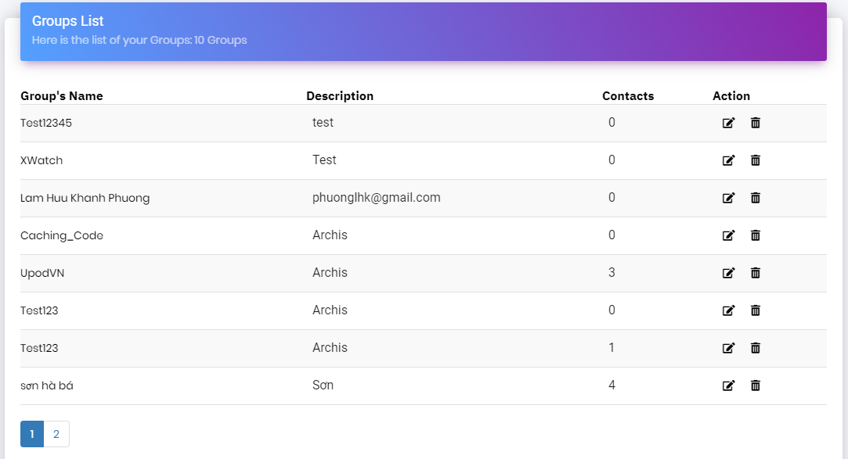
Group contact
Create group
Edit group
View detail
Create segment
15

Slide 22
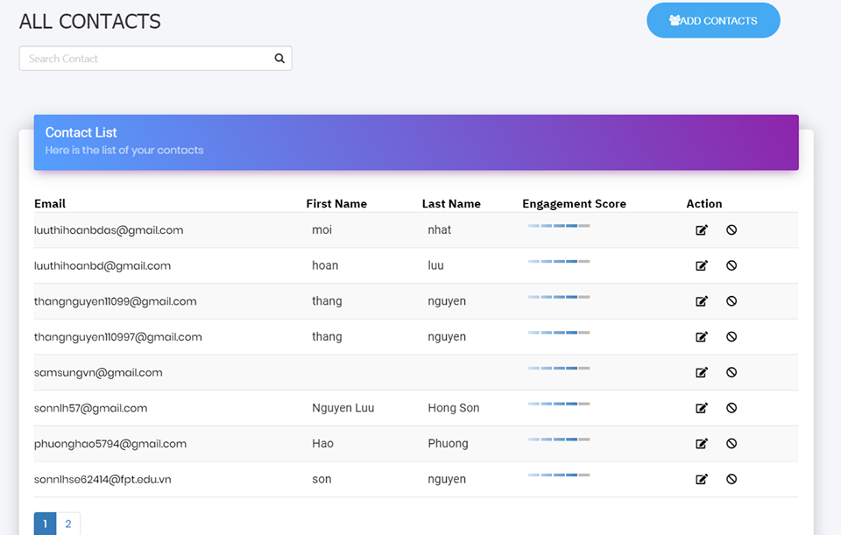
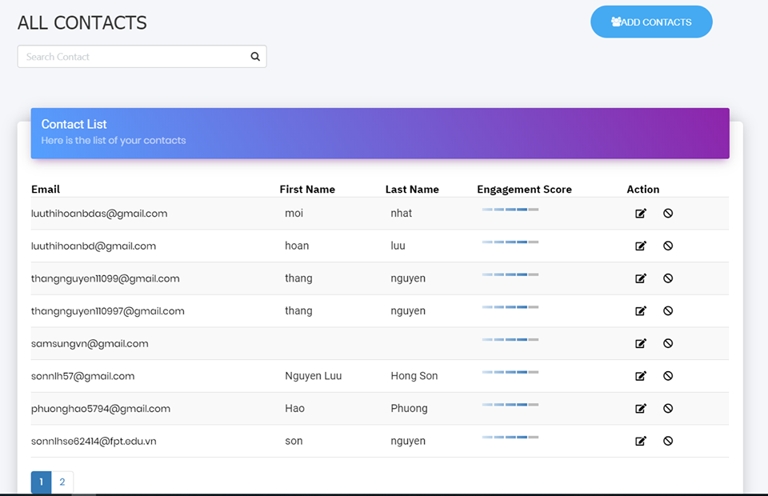
Contact
Add contact
Edit contact
View detail
Move to blacklist
15

Slide 23
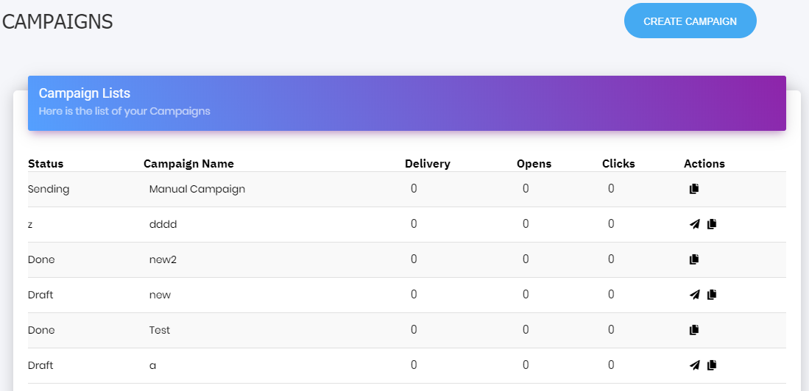
Regular campaign
Create campaign
Edit campaign
View detail
Copy campaign
15

Slide 24
Workflow
Create group
Edit group
View detail
Create segment
15

Slide 25
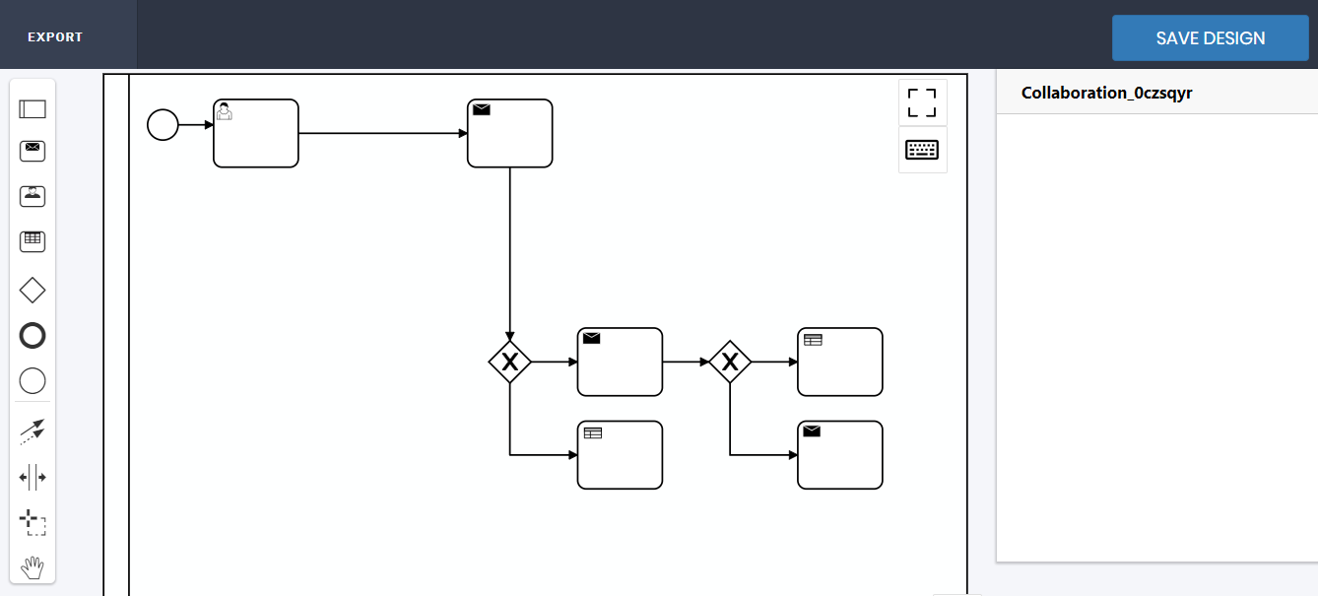
Workflow
Create workflow
View detail
15

Slide 26
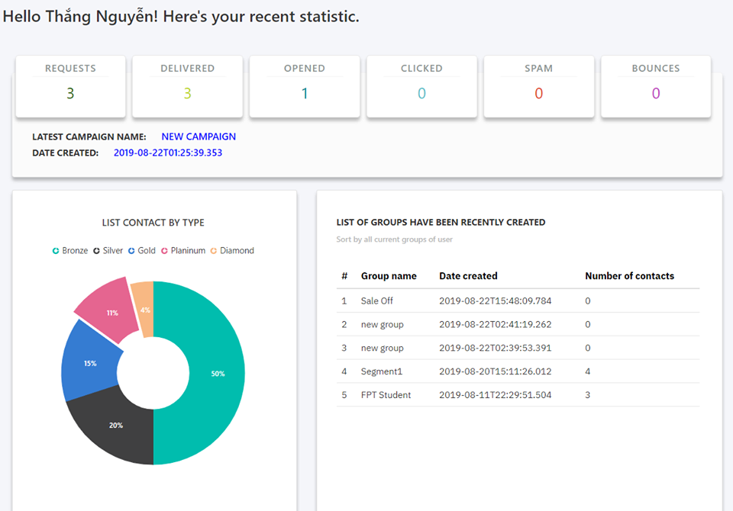
Dashboard
View detail
15

Slide 27

3. Idea & Solution
20

Slide 28



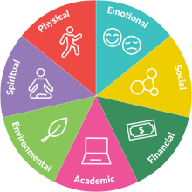













4. Outcome
29

Slide 29













5. Future Plan
30

Slide 30




Thanks for listening!
32

Slide 31
Q & A
31

